Slide 1
FCC-ee Machine Detector Interface MDI
Activities at SLAC
John T. Seeman
for the MDI Team
SLAC Accelerator Directorate
December 15, 2025

Slide 2
“SLAC Collider/MDI Accelerator Design” Collaborations (Labs and Universities)
BNL: EIC+FCCee: design lattice, e- beams, IR corrector magnet specs
CERN: FCCee: IR design, magnets, IR cryostats, backgrounds
KEK: SuperKEKB: Sudden Beam Loss, IP dither feedback, Linac upgrades, Belle II backgrounds, XRM
Univ Hawaii: SuperKEKB Nanometer X-Ray beam size Monitors (XRM)
Design / MDI collaborations with external colleagues have been very fruitful.

Slide 3
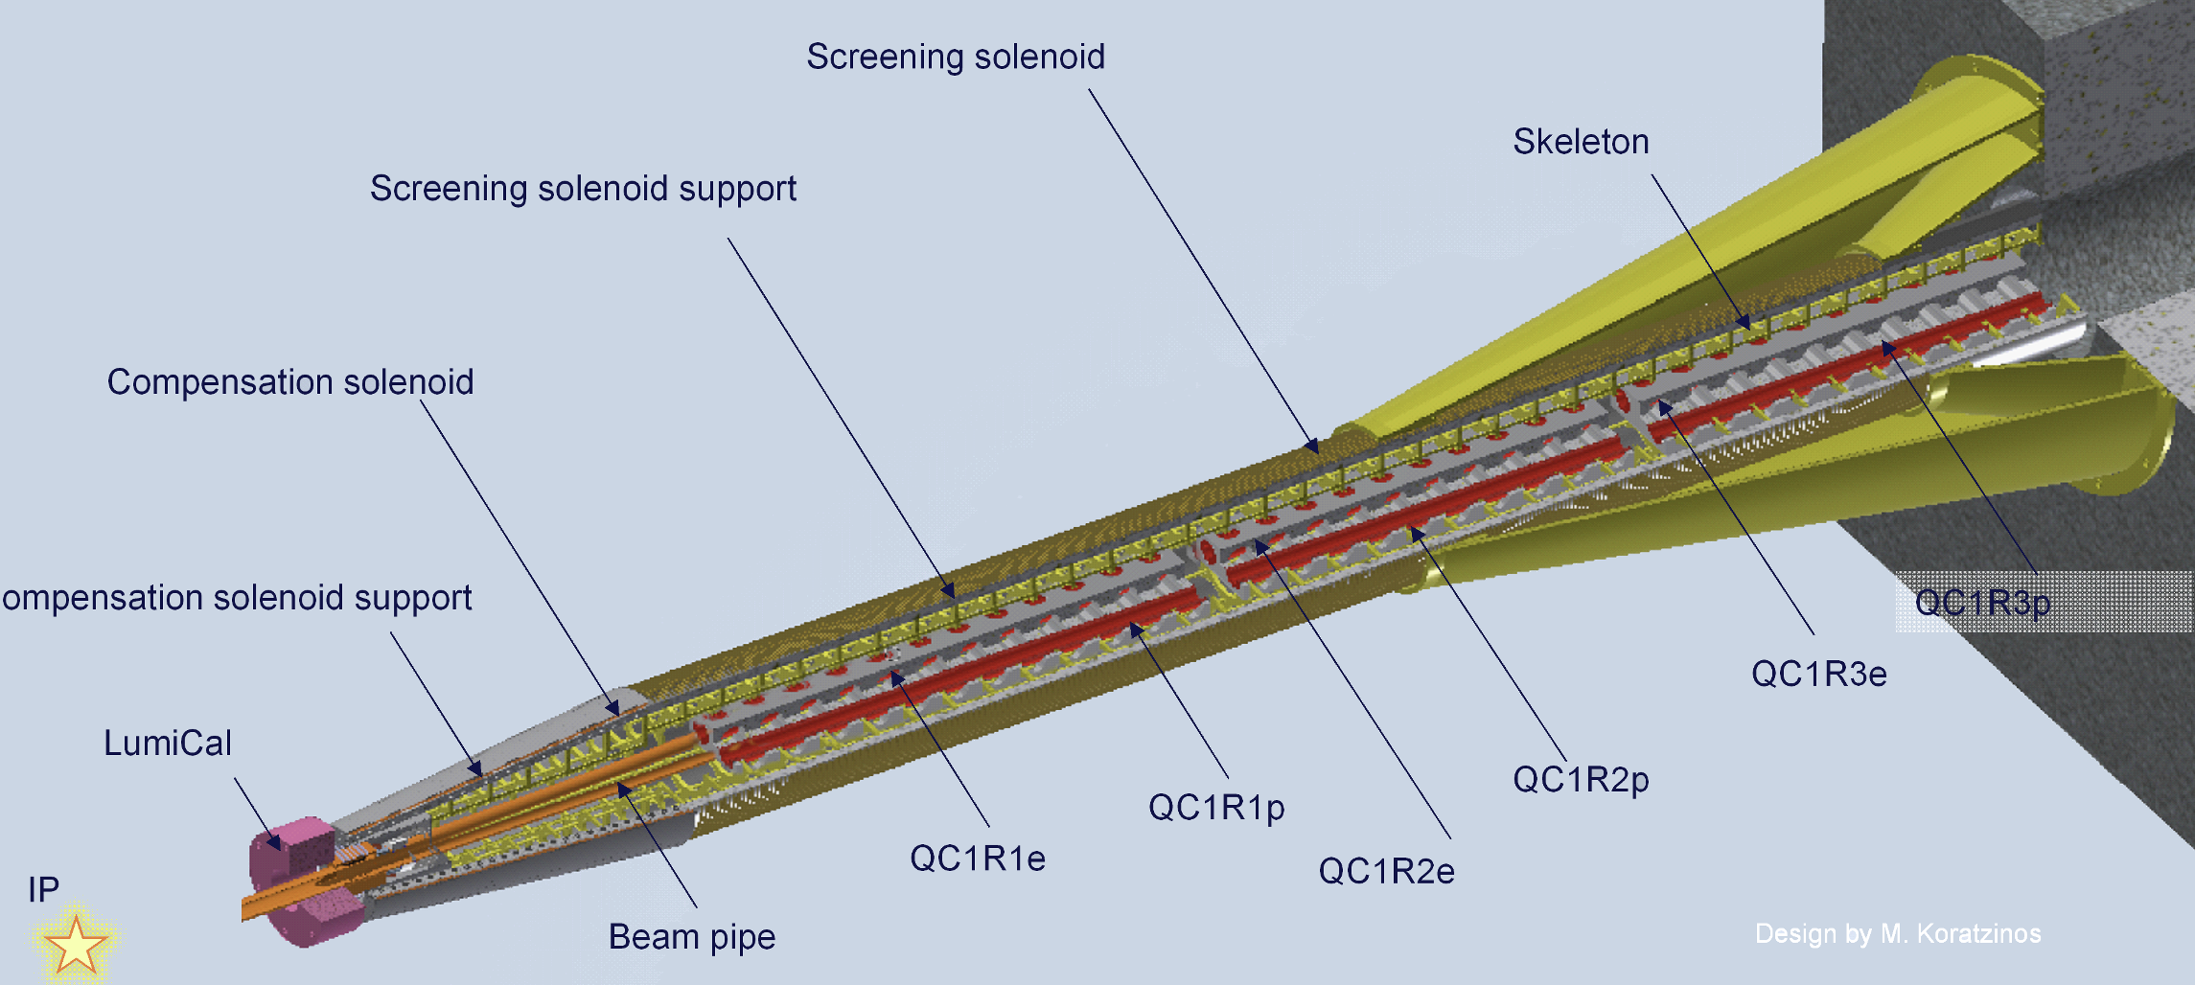
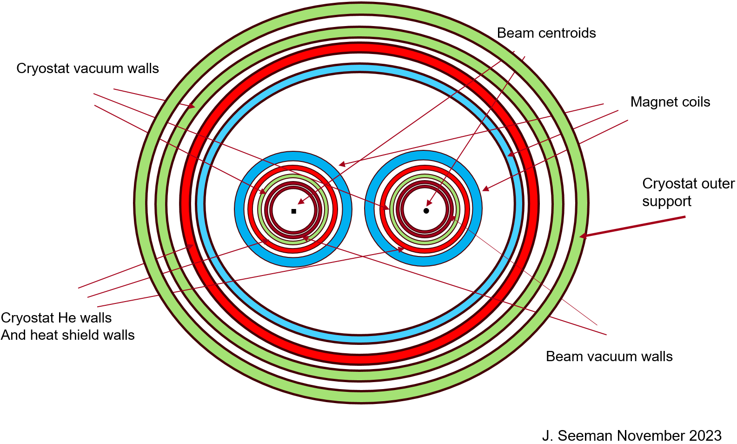
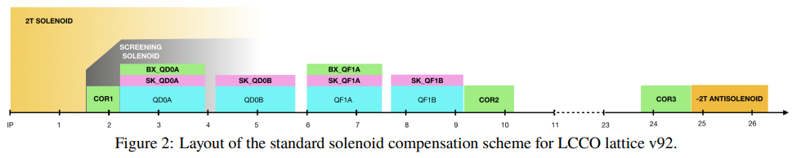
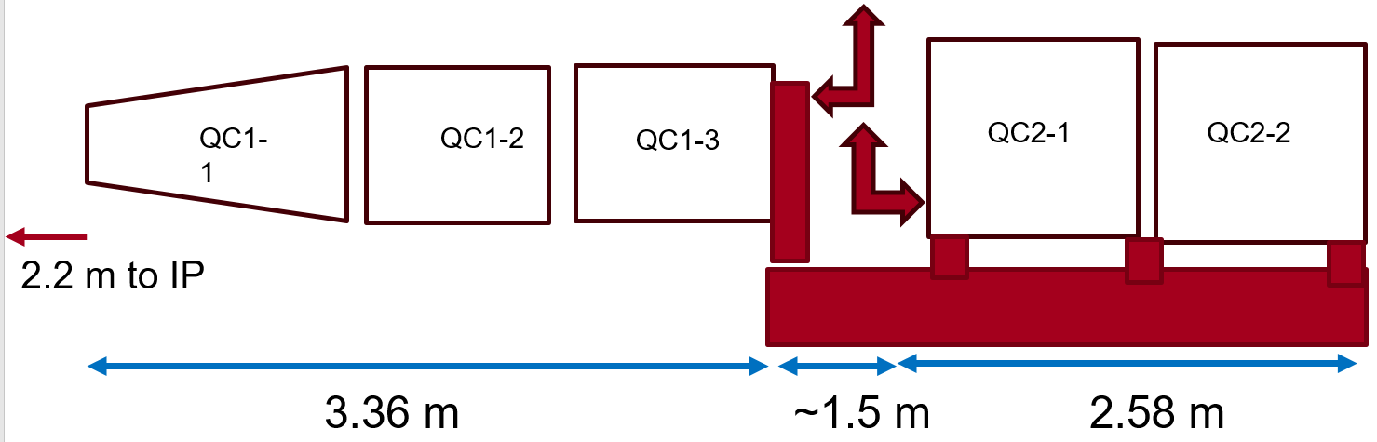
FCCee: MDI, Magnets, Cryostat [J. Seeman, M. Boscolo, M. Koratzinos, P. Borges de Sousa, …]
On-going identified FCCee MDI studies:
Add inner background shielding: W, Ta, or Cu.
Resolve new IR lattice vs present: QC1,QC2 placement.
Make initial cryostat design (4 or 7 m) by cryogenic/mechanical engineer(s).
Answer if IR magnets need higher-order trim coils.
Confirm 100 mrad detector-accelerator cone angle.
IR BPMs and other diagnostics.
Full list of magnet, vacuum, and cryogenic specifications.
Converge on background mask geometry .
Make initial layout of magnet/cryogenic splice box.
Construct a left and right CCT magnet pair for QC1.
Test CCT quadrupole for reduced left-right field cross-talk.
Design remote vacuum flanges (need 6 flanges with 2 designs).
Radial differential movement problems during cool down.
M. Boscolo et al, IPAC2024 Nashville, TN, and FCC Week.
Seeman FCC Week, San Francisco , CA, May 2024

Slide 4
Q1: What are the near-term research topics on MDI at AD-SLAC (~1 year)
  SLAC:
    Confirm present IR magnet, vacuum, HOM layouts (Novokhatski, Seeman)
    Investigate QC1/2 cryostat design and fluid flows (Seeman + engineer)
    Investigate a vacuum-magnet IP mock-up of QC1 (Seeman + engineer)
    Help complete layout of solenoid coupling compensation scheme (Participate in review: Cai, Seeman)
    Contribute to SuperKEKB background mitigations (Sullivan)
    Help with SuperKEKB 2026 beam run (Dusatko, Fisher, Sullivan)
    SuperKEKB XRM (Ruckman)
  LBNL:
    Interact for direct wind IP corrector magnet designs.

Slide 5
Thank you for your attention!
Questions?

Slide 6
2. What are the goals and deliverables for the current research effort, assuming no additional funding (2-3 years)?
FCCee: Provide additional input for the European Strategy Update by Spring 2026. (MDI, IR HOMs, Backgrounds, Cryostats).
SuperKEKB: Provide input studies for 2026/2027 beam runs. (Sudden Beam Loss, IR Dither Feedback, Linac emittances, ).
EIC: Study further IR HOM reduction, polarization equipment (x-ray power) protection, kicker magnet designs, beam dynamics DA and losses, injector linac design.
Knowledge transfer: Engage the next generation builders in collider design strategies and techniques.
Enlist new collaborators on MDI, particularly for IR cryostats, mechanical, and vacuum.
Engage a graduate student for collider design studies.

Slide 7
Q3. What are the longer range “aspirational” goals and deliverables if more funding becomes available (5-10 years)?
Goal: Find final components/systems that FCCee and SLAC want to build.
Examples:
Mock-up FCCee: Build a full scale (non-vacuum) IR magnet cryostat and raft (~0.4 M$)
Const. FCCee: Build final 3 full IR magnet cryostats (2 used,1 spare) for an IR.
Const. FCCee : Build final dither steering IP beam luminosity feedbacks.

Slide 8
Q4. What are the long range problems you want to address and what resources (people) are needed?
Staffing recruitment and training:
Project technical construction managers
Cryogenic/magnet/beam physicists
Cryogenic/magnet/mechanical engineers
Cryogenic/mechanical safety expert
Develop a construction and test facility for IR cryostats:
(Use Heavy Fabrication Building and extend CMTF at SLAC)?

Slide 9
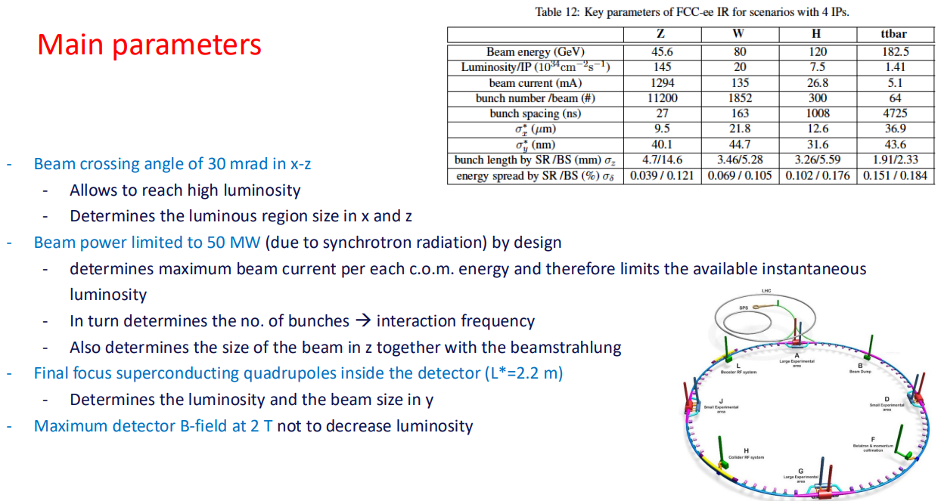
FCCee Accelerator Parameters

Slide 10
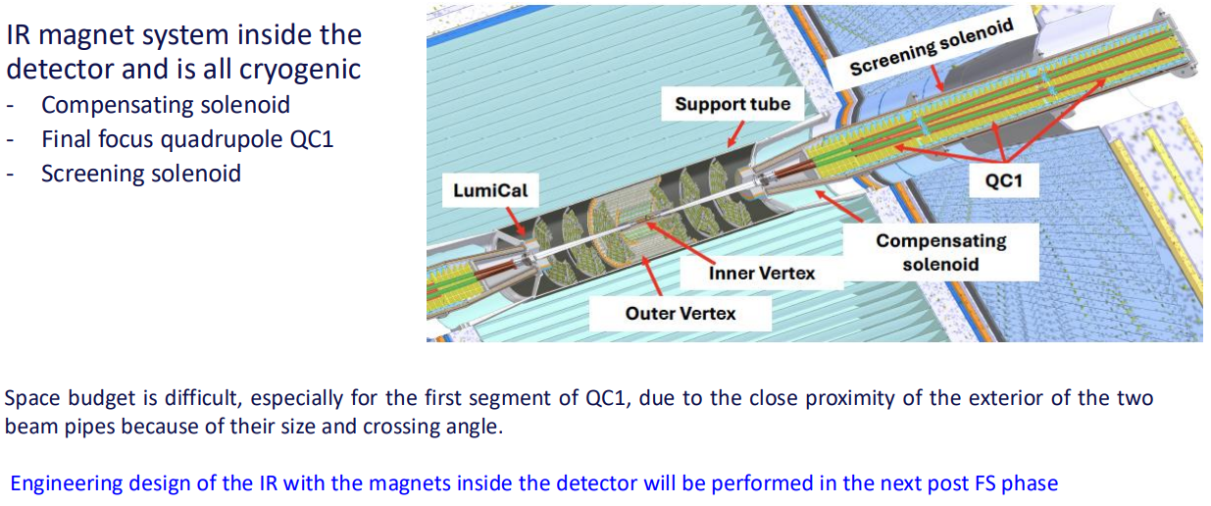
FCCee IR Accelerator SC Magnets and Cryostat

Slide 11
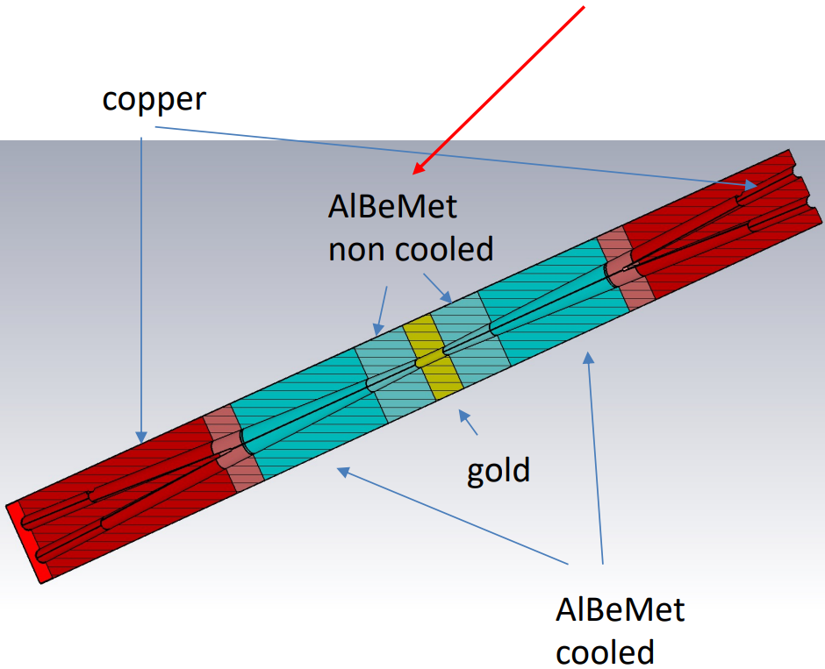
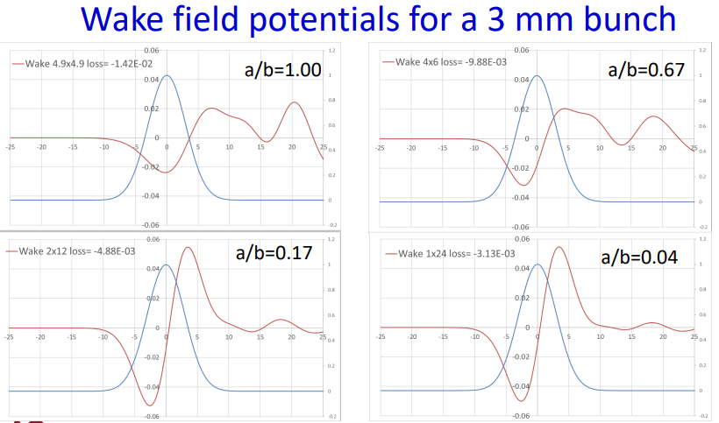
FCCee IR HOM Calculations and Suppression [A. Novokhatski, F. Fransesini (INFN-Frascati)]
FCCee
IR chamber
cross section
and materials
Mode power vs mode frequency
New IP design updated every month with SLAC’s HOM contributions included in mechanical layouts, leading toward the upcoming European Strategy update.
F. Fransesini et al, IPAC 2024, Nashville, TN.
A. Novokhatski, p. 2687, J. Phys. 2024, 022031.
HOM strength vs time

Slide 12
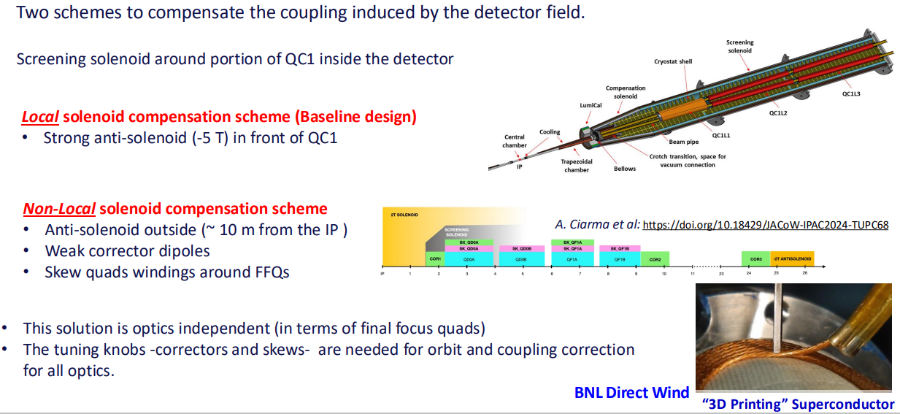
IR Accelerator Optics – Solenoid Compensation

