Slide 1


Some opportunity Beyond $ν$’s and $e$’s
Symmetry mag.
L. Dixon
PoU Intensity Frontier Brainstorming
September 26, 2025

Slide 2
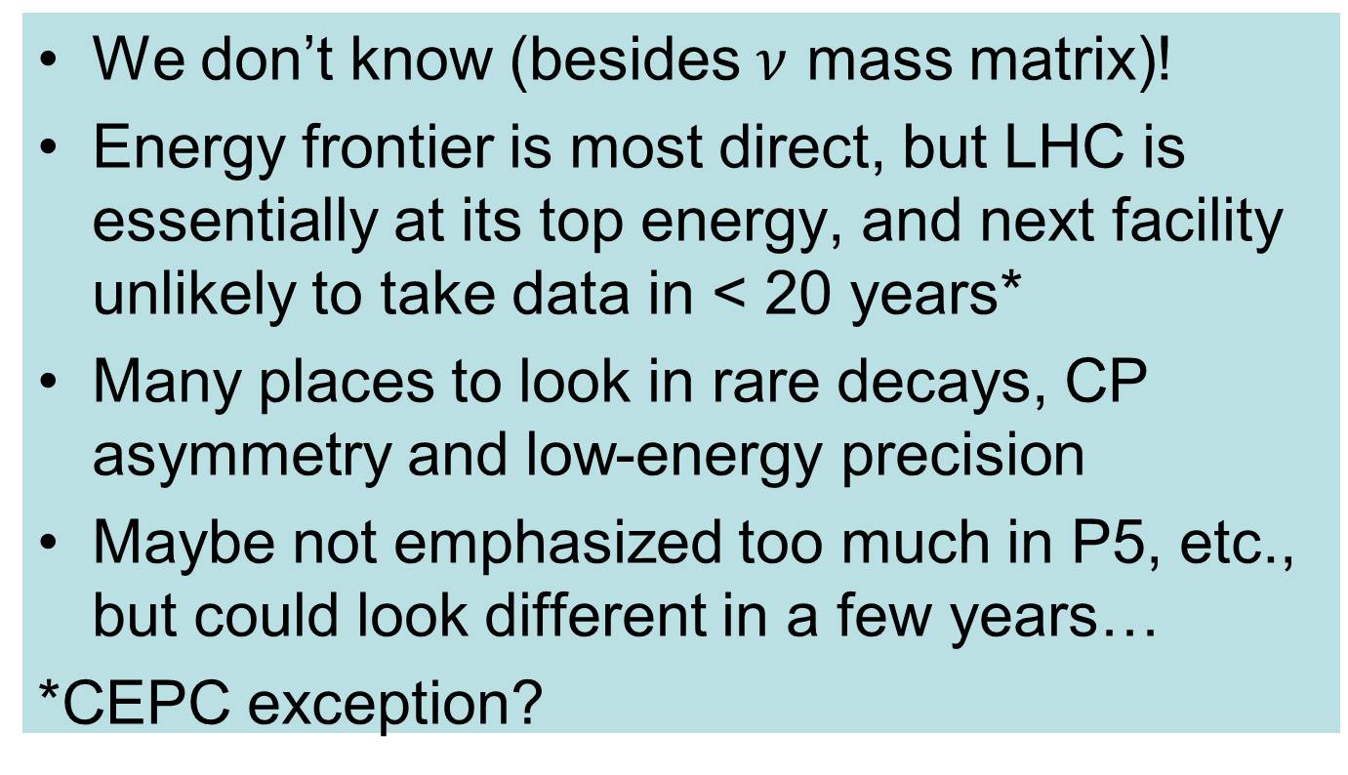
Where will we find physics beyond the Standard Model?
We don’t know (besides $ν$ mass matrix)!
Energy frontier is most direct, but LHC is essentially at its top energy, and next facility unlikely to take data in < 20 years*
Many places to look in rare decays, CP asymmetry and low-energy precision
Maybe not emphasized too much in P5, etc., but could look different in a few years…
*CEPC exception?

Slide 3
If new physics violates (approximate) SM symmetries…
from 1910.11775

Slide 4

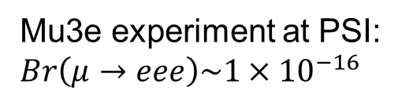

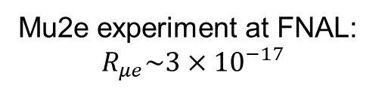
Charged LFV in $μ$’s
$μ^{−}→e^{−}$ conversion in Al ($μeγ^{∗}$, $μeq\overline{q}$ interactions)
$μ^{+}→e^{+}e^{−}e^{+}$
Mu2e experiment at FNAL:
$$R_{μe}\sim 3×{10}^{−17}$$
Mu3e experiment at PSI:
$$Br\left(μ→eee\right)\sim 1×{10}^{−16}$$

Slide 5

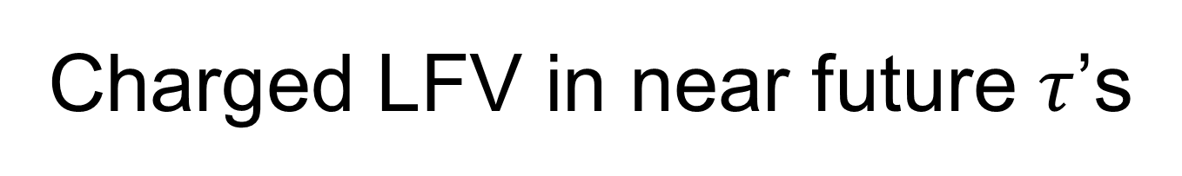
Charged LFV in near future $τ$’s
$Br\left(τ→μμμ\right)<4.6×{10}^{−8}$ (LHCb)
Otherwise mostly Belle II going forward?
2203.14919

Slide 6

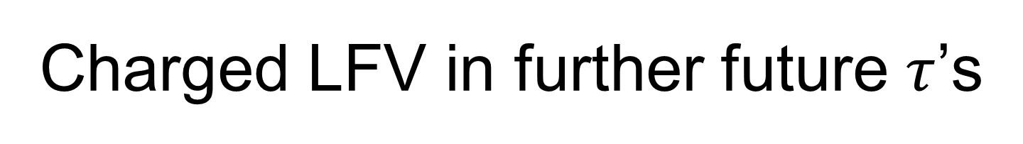
Charged LFV in further future $τ$’s
$Super τ charm factory at BES aims at {10}^{10} τ^{+}τ^{−}pairs$
FCC-ee (energy frontier, 2045) will also run at Z pole, and aims at ${2.6 ×10}^{11} τ^{+}τ^{−}pairs$

Slide 7

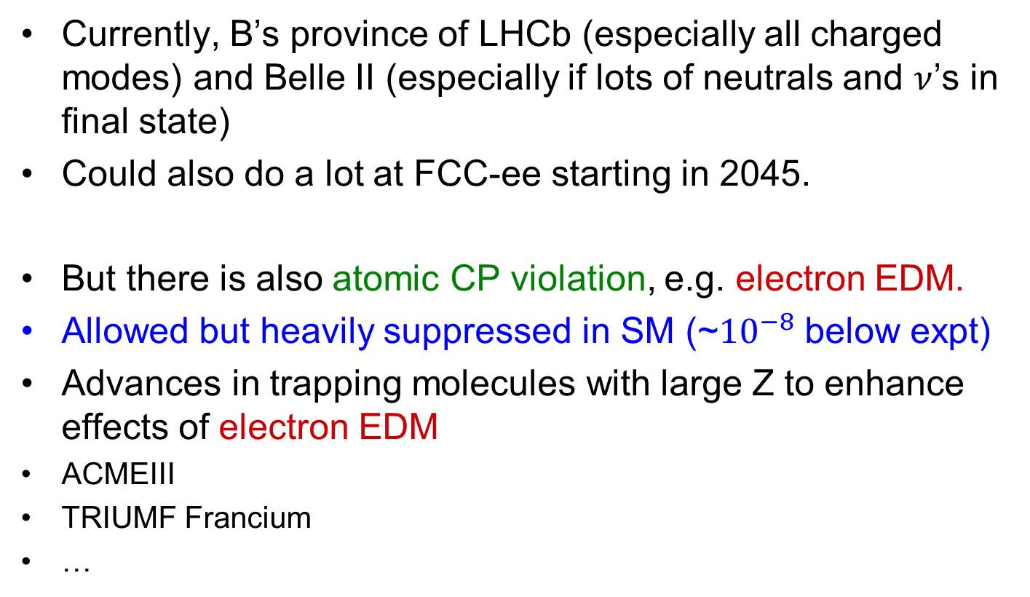
Rare meson decays, CPV
Currently, B’s province of LHCb (especially all charged modes) and Belle II (especially if lots of neutrals and $ν$’s in final state)
Could also do a lot at FCC-ee starting in 2045.
But there is also atomic CP violation, e.g. electron EDM.
Allowed but heavily suppressed in SM (~${10}^{−8}$ below expt)
Advances in trapping molecules with large Z to enhance effects of electron EDM
ACMEIII
TRIUMF Francium
…
Harvard, Caltech, ASU, Toronto

Slide 8
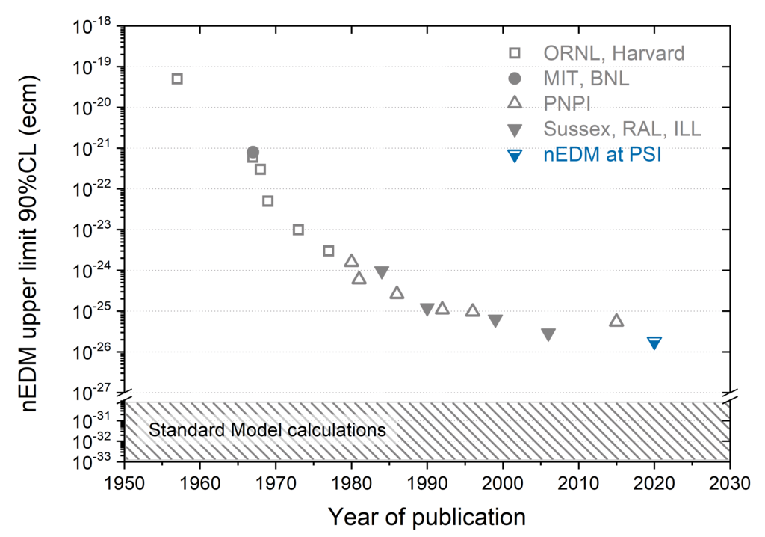
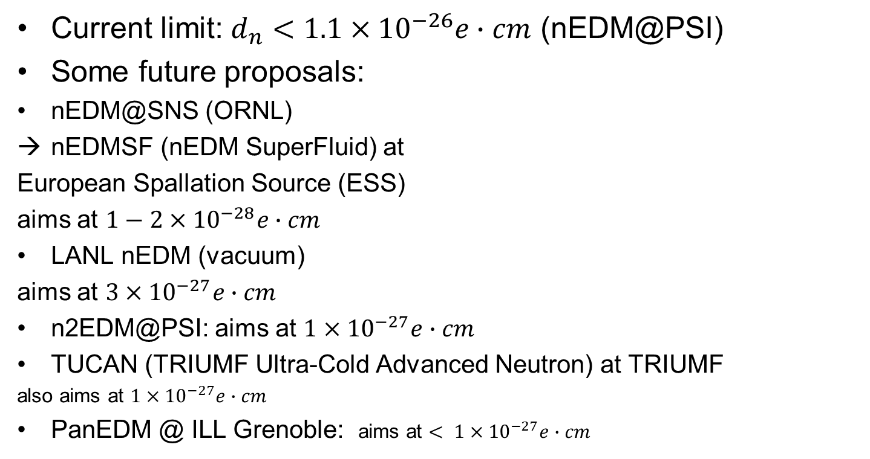
Also neutron EDM
Current limit: $d_{n}<1.1×{10}^{−26}e∙cm$ (nEDM@PSI)
Some future proposals:
nEDM@SNS (ORNL)
nEDMSF (nEDM SuperFluid) at
European Spallation Source (ESS)
aims at $1−2×{10}^{−28}e∙cm$
LANL nEDM (vacuum)
aims at $3×{10}^{−27}e∙cm$
n2EDM@PSI: aims at $1×{10}^{−27}e∙cm$
TUCAN (TRIUMF Ultra-Cold Advanced Neutron) at TRIUMF
also aims at $1×{10}^{−27}e∙cm$
PanEDM @ ILL Grenoble: aims at $< 1×{10}^{−27}e∙cm$

Slide 9
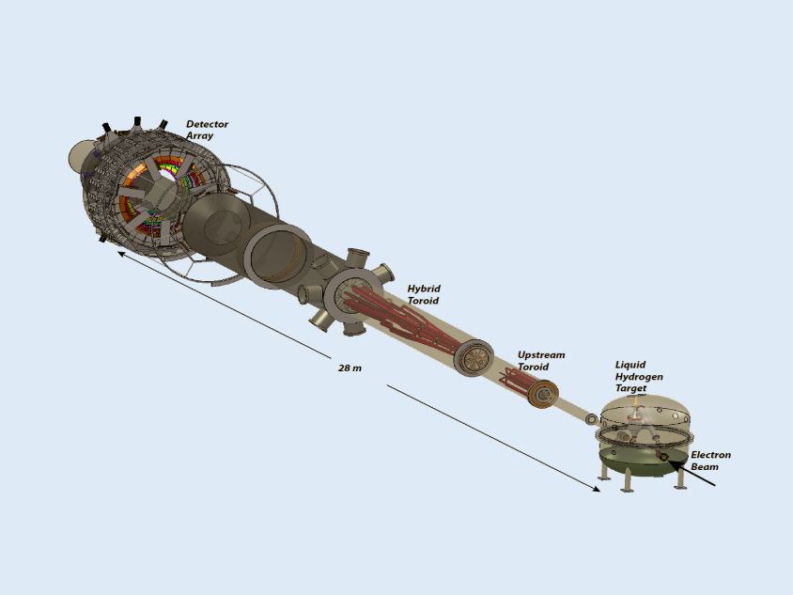
Other lower energy precision measurements?
Muon g-2 just completed experiment at Fermilab; unfortunately, currently limited by theory (hadronic vacuum polarization).
MOLLER experiment at JLAB (11 GeV beam), parity violation in electron-electron scattering (OK this is with electrons)

